Slide 1
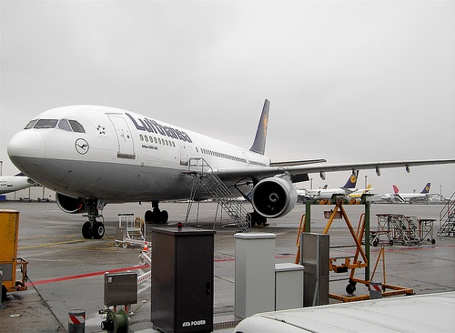
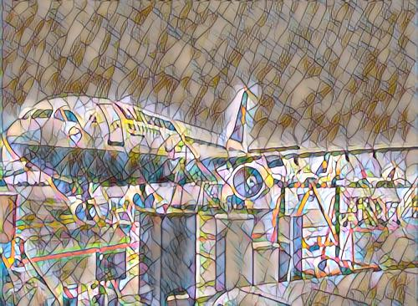

Fast Neural Style Transfer
ECE 285 Project
Unay Shah (A59015777)
Prithwiraj Paul (A59020278)
Electrical and Computer Engineering (ECE)

Slide 2
Motivation
Existing style transfer methods lack flexibility in assigning different styles to different regions.
Combining style transfer with semantic segmentation enables precise control over object-specific styles.
Real-time performance is crucial for dynamic and interactive style transfer applications.
The project aims to seamlessly integrate fast style transfer and semantic segmentation for efficient and visually captivating results.
The proposed objective for this project is to create a pipeline that enables diverse styles for different elements within an image addressing the limitations of existing methods.

Slide 3
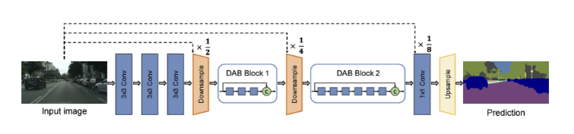
Existing Fast Semantic Segmentation Models
DABNet: Depthwise Asymmetric Bottleneck module for fast semantic segmentation.
Efficiently extracts local and contextual features.
Balances accuracy and inference speed.
Achieves a Mean Intersection over Union (Mean IoU) of 70.1% on the Cityscapes dataset.
Operates at a speed of 104 frames per second on a single GTX 1080Ti card.

Slide 4
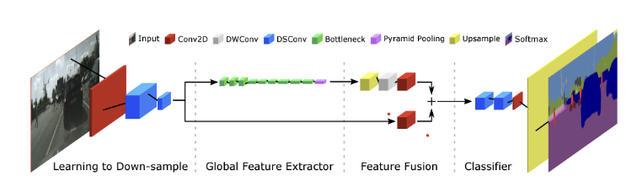
Fast Semantic Segmentation Models (Continued..)
Fast-SCNN: Fast Segmentation Convolutional Neural Network
Relies on depthwise separable convolutions and residual bottleneck blocks.
Incorporates a "learning to downsample" module for shared feature extraction at multiple resolutions.
Combines spatial details at high resolution with deep features at lower resolution.
Achieves a Mean IoU of 68.0% on the Cityscapes dataset.
Operates at a speed of 123.5 frames per second.

Slide 5
Choice of Fast Semantic Segmentation Model for our study
Selected FAST-SCNN model for real-time fast-style transfer.
Factors: accuracy, speed, computational resources, model size.
FAST- SCNN offers fast inference with good accuracy.
Utilizes "learning to downsample" module for feature computation.
Combines high-resolution spatial details with deep features.
Achieves 68.0% accuracy on Cityscapes dataset.
Operates at 123.5 frames per second.

Slide 6
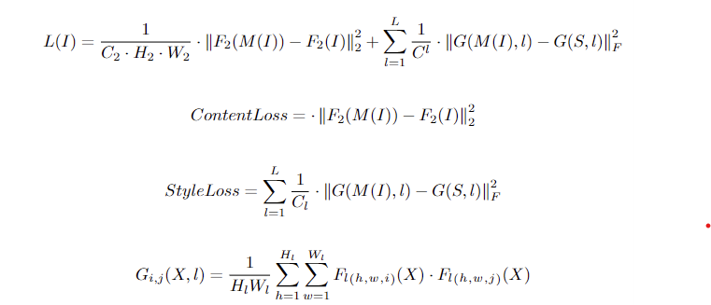
Fast Neural Style Transfer
Localized real-time style transfer applies neural style transfer to specific regions within images.
Real-time stylized image generation: Combines input image content with style image using FSM. Fast styling method (FSM) by Johnson et al. is used, employing a fully convolutional neural network (FCN).
Loss functions: Content loss (L2 norm) preserves spatial structure, style loss (Gram matrix) maintains style characteristics.

Slide 7
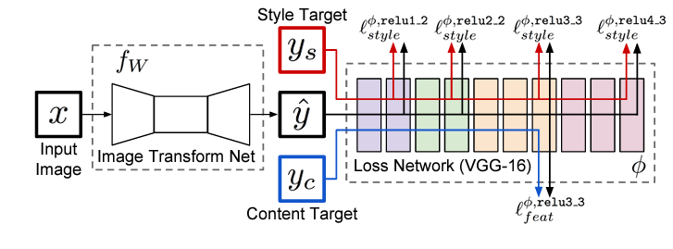
Neural Style Transfer Model

Slide 8
Methodology
Optimized combination: Generates stylized images with preserved structure and desired style.
Real-time performance: Single forward pass eliminates iterative optimization for fast generation.
Style Transfer Process
Two-step process: Foreground mask extraction (FAST-SCNN) and stylized image generation (custom Neural Style Transfer Model).
Final stylized image: Merges object-specific styles based on object index and semantic segmentation features.

Slide 9
Pipeline Architecture
Semantic Segmentation using FAST-SCNN model
Segmented Image
Input:
Cityscape Image
Style Application: apply different style for each segmented object in the image
Output: Diverse-stylized image
Different Pre-trained Style Transfer Models
Full-stylized Image
We have designed the pipeline such that training and testing can be done using arguments in the python command. These have been detailed in the Readme file.
With arguments, each of the models can be trained and tested, and the entire pipeline can be run. Custom datasets and style images can be specified.

Slide 10
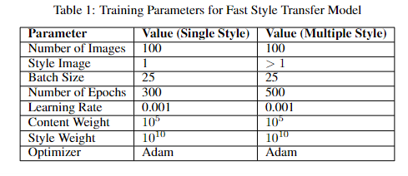
Training Methodology

Slide 11
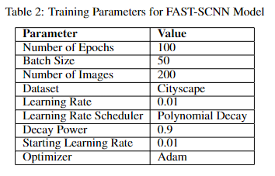

Slide 12
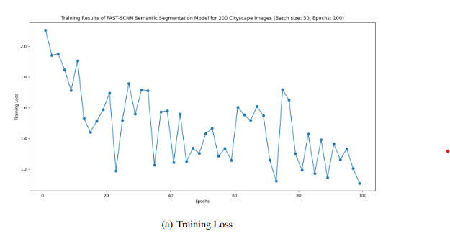
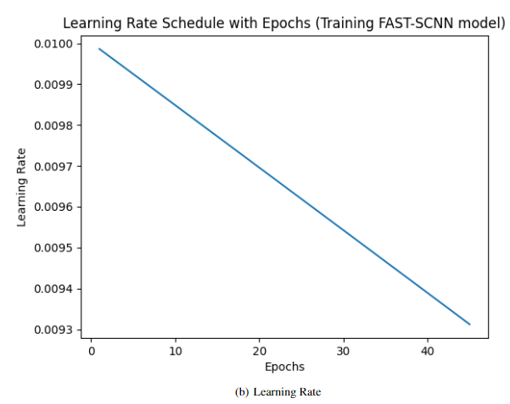
Training Results - FAST SCNN Model

Slide 13
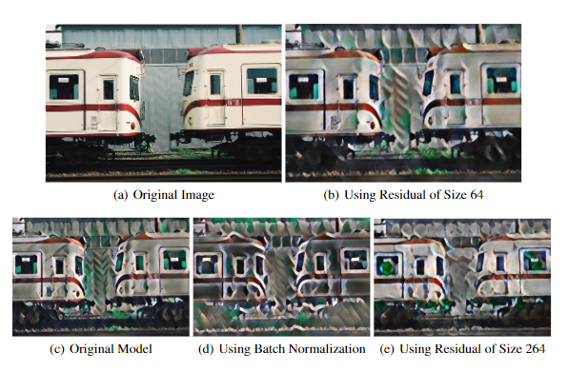
Ablation Study

Slide 14
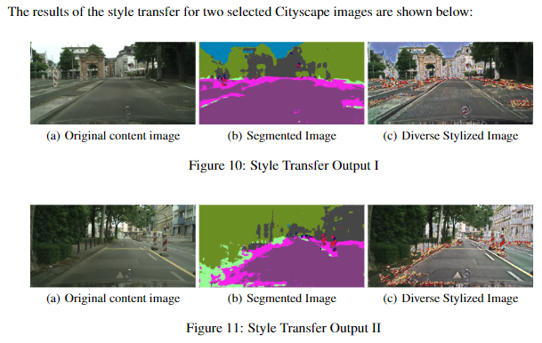
Results from the combined custom-made pipeline

Slide 15
Conclusion
Our Fast style transfer model operates at speeds between 20-25 fps.
The pipeline operates at a speed of 1 fps (frames per second) - limited by the speed of FAST-SCNN model
Room for improvement lies in optimizing the FAST-SCNN model

